Slide 1

Angular Concepts
[Phong Ha]

Slide 2
Content
What is Angular
Modules
Components
Services and DI
Routing
Hook

Slide 3
What is Angular
Angular is a platform and framework for building single-page client applications using HTML and TypeScript. Angular is written in TypeScript. It implements core and optional functionality as a set of TypeScript libraries that you import into your apps.
Angular is a client-side JavaScript framework that was specifically designed to help developers build SPAs (Single Page Applications) in accordance with best practices for web development. By providing a structured environment for building SPAs, the risk of producing “spaghetti code” is highly reduced.

Slide 4
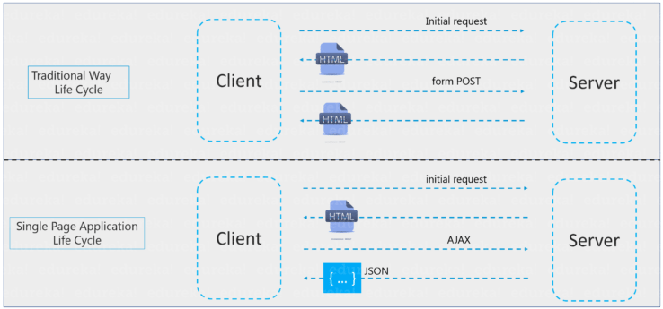
Single-Page Applications
Single-Page Applications (or SPA’s) are applications that are accessed via a web browser like other websites but offer more dynamic interactions resembling native mobile and desktop apps. The most notable difference between a regular website and SPA is the reduced amount of page refreshes. SPAs have a heavier usage of AJAX- a way to communicate with back-end servers without doing a full page refresh to get data loaded into our application. As a result, the process of rendering pages happens mostly on the client-side.

Slide 5
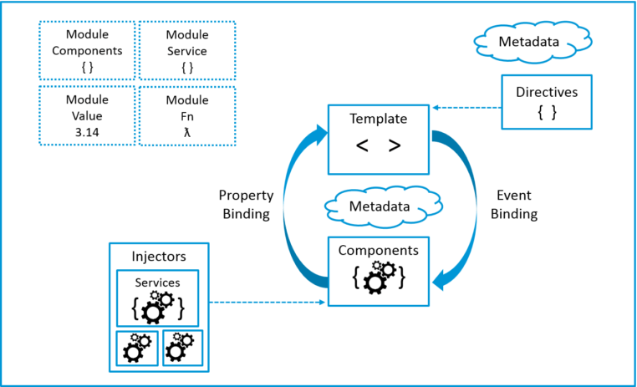
Architecture

Slide 6
Introduction to modules
Angular apps are modular and Angular has its own modularity system called NgModules. NgModules are containers for a cohesive block of code dedicated to an application domain, a workflow, or a closely related set of capabilities. They can contain components, service providers, and other code files whose scope is defined by the containing NgModule. They can import functionality that is exported from other NgModules, and export selected functionality for use by other NgModules.
Every Angular app has at least one NgModule class, the root module, which is conventionally named AppModule and resides in a file named app.module.ts. You launch your app by bootstrapping the root NgModule.
While a small application might have only one NgModule, most apps have many more feature modules. The root NgModule for an app is so named because it can include child NgModules in a hierarchy of any depth

Slide 7
NgModule metadata
Decorators are functions that modify JavaScript classes. Decorators are basically used for attaching metadata to classes so that, it knows the configuration of those classes and how they should work. NgModule is a decorator function that takes metadata objects whose properties describe the module. The properties are:
declarations: The classes that are related to views and they belong to this module. There are three classes of Angular that can contain view: components, directives, and pipes.
exports: The subset of declarations that should be visible and usable in the component templates of other NgModules.
imports: Other modules whose exported classes are needed by component templates declared in this NgModule.
providers: Creators of services that this NgModule contributes to the global collection of services; they become accessible in all parts of the app. (You can also specify providers at the component level.)
bootstrap: The main application view, called the root component, which hosts all other app views. Only the root NgModule should set the bootstrap property.

Slide 8
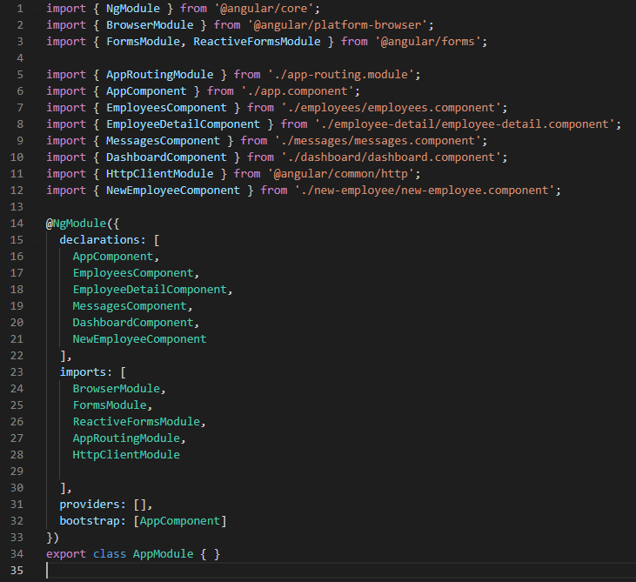
Take a look at how the root module looks like

Slide 9
Introduction to components and templates
A component controls a patch of screen called a view. For example, individual components define and control each of the following views from the Employee Demo:
The app root with the navigation links.
The list of employees.
The employee editor.
etc
You define a component's application logic—what it does to support the view—inside a class. The class interacts with the view through an API of properties and methods.

Slide 10
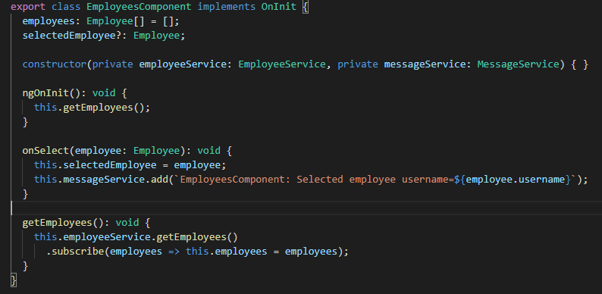
Example of Component

Slide 11
Component metadata
The @Component decorator identifies the class immediately below it as a component class, and specifies its metadata. In the example code below, you can see that EmployeesComponent is just a class, with no special Angular notation or syntax at all. It's not a component until you mark it as one with the @Component decorator.
The metadata for a component tells Angular where to get the major building blocks that it needs to create and present the component and its view. In particular, it associates a template with the component, either directly with inline code, or by reference. Together, the component and its template describe a view.
In addition to containing or pointing to the template, the @Component metadata configures, for example, how the component can be referenced in HTML and what services it requires.

Slide 12
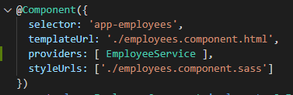
Example of Component metadata
selector: A CSS selector that tells Angular to create and insert an instance of this component wherever it finds the corresponding tag in template HTML. For example, if an app's HTML contains <app-employees></app-employees>, then Angular inserts an instance of the EmployeesComponent view between those tags.
templateUrl: The module-relative address of this component's HTML template. This template defines the component's host view.
providers: An array of providers for services that the component requires. In the example, this tells Angular how to provide the EmployeeService instance that the component's constructor uses to get the list of heroes to display.
styleUrls: Gives the path of the CSS style sheet.

Slide 13
Template syntax
A template looks like regular HTML, except that it also contains Angular template syntax, which alters the HTML based on your app's logic and the state of app and DOM data. Your template can use data binding to coordinate the app and DOM data, pipes to transform data before it is displayed, and directives to apply app logic to what gets displayed.

Slide 14
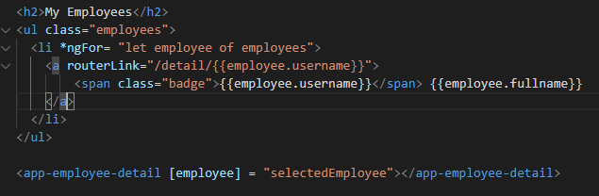
Example of Template
This template uses typical HTML elements like <h2> and also includes Angular template-syntax elements, *ngFor, {{employee.username}}, [employee], and <app-employee-detail>. The template-syntax elements tell Angular how to render the HTML to the screen, using program logic and data.

Slide 15
Example of Template
The *ngFor directive tells Angular to iterate over a list.
{{employee.username}}, and [employee] bind program data to and from the DOM, responding to user input. See more about data binding below.
The <app-hero-detail> tag in the example is an element that represents a new component, HeroDetailComponent. HeroDetailComponent (code not shown) defines the hero-detail child view of HeroListComponent. Notice how custom components like this mix seamlessly with native HTML in the same layouts.

Slide 16
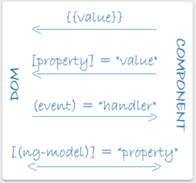
Data binding
The following diagram shows the four forms of data binding markup. Each form has a direction: to the DOM, from the DOM, or both.
interpolation {{value}} displays the component's property value within the tag element.
property binding [property] passes the value from the parent to the child
event binding (click) calls the compnenet’s method when user click on HTML
Two-way data binding is an important part as it combines property and event binding in a single notation, using the ngModel directive.

Slide 17
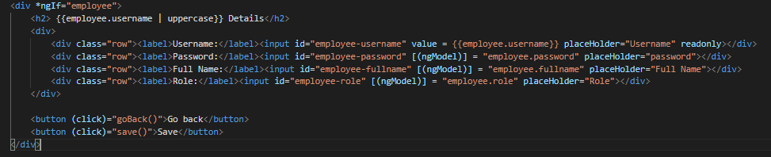
Example of Data binding

Slide 18
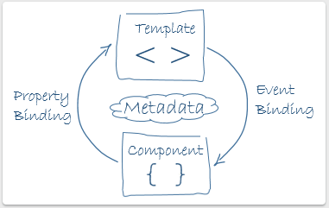
Two-way data binding
In two-way binding, a data property value flows to the input box from the component as with property binding. The user's changes also flow back to the component, resetting the property to the latest value, as with event binding.

Slide 19
Directives
Angular templates are dynamic. When Angular renders them, it transforms the DOM according to the instructions given by directives. A directive is a class with a @Directive decorator.
A component is a directive-with-a-template; a @Component decorator is actually a @Directive decorator extended with template-oriented features.
Just as for components, the metadata for a directive associates the decorated class with a selector element that you use to insert it into HTML. In templates, directives typically appear within an element tag as attributes, either by name or as the target of an assignment or a binding.

Slide 20

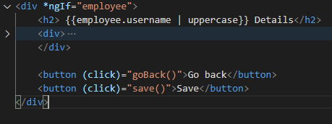
Structural directives
Structural directives alter layout by adding, removing, and replacing elements in the DOM.
*ngFor is an iterative; it tells Angular to stamp out one <li> per employee in the employees list.
*ngIf is a conditional; it includes the Employee Detail component only if a selected employee exists.

Slide 21
Attribute directives
Attribute directives alter the appearance or behavior of an existing element. In templates they look like regular HTML attributes, hence the name.
The ngModel directive, which implements two-way data binding, is an example of an attribute directive. ngModel modifies the behavior of an existing element (typically <input>) by setting its display value property and responding to change events.

Slide 22
Introduction to services and dependency injection
Service is a broad category encompassing any value, function, or feature that an app needs. A service is typically a class with a narrow, well-defined purpose. It should do something specific and do it well.
A good component presents properties and methods for data binding.
A component can delegate certain tasks to services, such as: logging, fetching data from the server or validating user input… By defining such processing tasks in an injectable service class, you make those tasks available to any component.
Angular doesn't enforce these principles. Angular does help you follow these principles by making it easy to factor your application logic into services and make those services available to components through dependency injection.

Slide 23
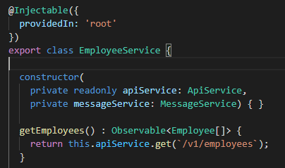
Service examples
Services can depend on other services. For example, here's a EmployeeService that depends on the ApiService get employees...

Slide 24

Dependency injection (DI)
DI is wired into the Angular framework and used everywhere to provide new components with the services or other things they need. Components consume services; that is, you can inject a service into a component, giving the component access to that service class.
To define a class as a service in Angular, use the @Injectable() decorator to provide the metadata that allows Angular to inject it into a component as a dependency. Similarly, use the @Injectable() decorator to indicate that a component or other class (such as another service, a pipe, or an NgModule) has a dependency.
The injector is the main mechanism. Angular creates an application-wide injector for you during the bootstrap process, and additional injectors as needed. You don't have to create injectors.
An injector creates dependencies, and maintains a container of dependency instances that it reuses if possible.
A provider is an object that tells an injector how to obtain or create a dependency.

Slide 25

Providing services
You must register at least one provider of any service you are going to use. You register providers in the metadata of the service (in the @Injectable() decorator), or in the @NgModule() or @Component() metadata
By default, the Angular CLI command ng generate service registers a provider with the root injector for your service
When you provide the service at the root level, Angular creates a single, shared instance of service and injects it into any class that asks for it. Registering the provider in the @Injectable() metadata also allows Angular to optimize an app by removing the service from the compiled app if it isn't used, a process known as tree-shaking.

Slide 26
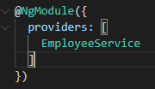
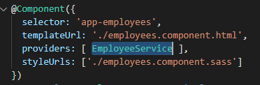
Providing services
When you register a provider with a specific NgModule, the same instance of a service is available to all components in that NgModule. To register at this level, use the providers property of the @NgModule() decorator.
When you register a provider at the component level, you get a new instance of the service with each new instance of that component. At the component level, register a service provider in the providers property of the @Component() metadata.

Slide 27
Routing
In a single-page app, you change what the user sees by showing or hiding portions of the display that correspond to particular components, rather than going out to the server to get a new page. As users perform application tasks, they need to move between the different views that you have defined.
To handle the navigation from one view to the next, you use the Angular Router. The Router enables navigation by interpreting a browser URL as an instruction to change the view.

Slide 28
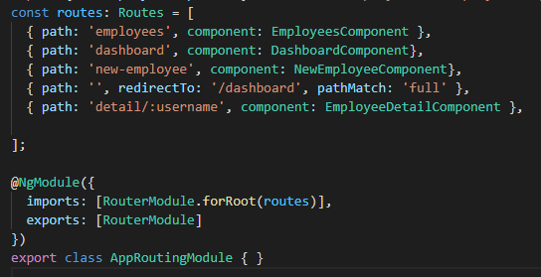
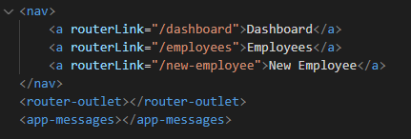
Routing
The CLI also sets up a Routes array for your routes and configures the imports and exports arrays for @NgModule()
path, defines the URL path for the route
component, defines the component Angular should use for the corresponding path.
Assign the anchor tag that you want to add the route to the routerLink attribute. Set the value of the attribute to the component to show when a user clicks on each link.
Next, update your component template to include <router-outlet>. This element informs Angular to update the application view with the component for the selected route.

Slide 29
Lifecycle
A component instance has a lifecycle that starts when Angular instantiates the component class and renders the component view along with its child views. The lifecycle continues with change detection, as Angular checks to see when data-bound properties change, and updates both the view and the component instance as needed. The lifecycle ends when Angular destroys the component instance and removes its rendered template from the DOM. Directives have a similar lifecycle, as Angular creates, updates, and destroys instances in the course of execution.
Your application can use lifecycle hook methods to tap into key events in the lifecycle of a component or directive in order to initialize new instances, initiate change detection when needed, respond to updates during change detection, and clean up before deletion of instances.

Slide 30
Lifecycle hooks
Lifecycle hooks are a special functionality in Angular that allow us to “hook into” and run code at a specific lifecycle event of a component or directive.
Angular manages components and directives for us when it creates them, updates them, or destroys them. With lifecycle hooks, we can gain better control of our application.
To do this, we add some specific hook methods prefixed with ng to our component or directive. These hooks are split into two types: hooks for components or directives, and hooks for child components.

Slide 31
Lifecycle event sequence
Angular executes hook methods in the following sequence. You can use them to perform the following kinds of operations.
ngOnChanges()
ngOnInit()
ngDoCheck()
ngAfterContentInit()
ngAfterContentChecked()
ngAfterViewInit()
ngAfterViewChecked()
ngOnDestroy()

Slide 32
ngOnChanges()
Purpose:
Respond when Angular sets or resets data-bound input properties.
Tracks current and Previous values.
Only tracks @Input property values.
Timing:
Called before ngOnInit() and whenever one or more data-bound input properties change.
Limitations:
Fails to detect changes user Object types.

Slide 33
ngOnInit()
Purpose:
Initialize the directive or component after Angular first displays the data-bound properties.
Sets the directive or component's input properties.
Timing:
Called once, after the first ngOnChanges().
Limitations:
A directive’s input properties are not set until constructor().

Slide 34
ngDoCheck()
Purpose:
Detect and act upon changes that Angular can't or won't detect on its own.
Timing:
Called immediately after ngOnChanges() on every change detection run.
Called immediately after ngOnInit() on the first run.
Limitations:
Called with an enormous frequency.
Dependency must be very less or the user experience suffers.

Slide 35
ngAfterContentInit()
Purpose:
Respond after Angular projects external content into the component's view, or into the view that a directive is in.
Timing:
Called once after the first ngDoCheck().

Slide 36
ngAfterContentChecked()
Purpose:
Respond after Angular checks the content projected into the directive or component.
Timing:
Called after ngAfterContentInit() and every subsequent ngDoCheck().

Slide 37
ngAfterViewInit()
Purpose:
Respond after Angular initializes the component's views and child views, or the view that contains the directive.
Timing:
Called once after the first ngAfterContentChecked().

Slide 38
ngAfterViewChecked()
Purpose:
Respond after Angular checks the component's views and child views, or the view that contains the directive.
Timing:
Called after the ngAfterViewInit() and every subsequent ngAfterContentChecked().

Slide 39
ngOnDestroy()
Purpose:
Cleanup just before Angular destroys the directive or component.
Unsubscribe Observables and detach event handlers to avoid memory leaks.
Timing:
Called immediately before Angular destroys the directive or component..

Slide 40

Thank You!

